Slide 1
Asymmetric Physical Layer Encryption for Wireless Communications
UNDER THE GUIDANCE OF
PROF . MR. SAYEESH
CSE -DEPARTMENT
NAME : VIGNESHA M. SHETTY
USN : 4AL16CS124
SECTION: B

Slide 2
CONTENTS
Introduction
Statement of the problem
Objectives
Scope for the study
Need for the study
Methodology
Application
Conclusion
References

Slide 3
Introduction
Security is always an important issue in communications networks, and more so for wireless networks due to its broadcast nature. .
Encryption has been the technology to provide security.
Such as different algorithms SNOW 3G, ZUC and AES.
But have faced new challenges in 5G scenarios.

Slide 4
In particular, the application scenarios, such as enhanced mobile broadband (eMBB), massive machine type communications, put new requirements on security.
Requirements are:
Low latency.
Low-power consumption and low complexity.
Heterogeneous access and massive users.
Simple and robust key distribution.
Security does not rely on channel information and eavesdropper status.

Slide 5
Author is looking for a secure communication method that meets the above ﬁve features for 5G scenarios.
PLE is a different approach from the bit layer cryptography and information theory based physical layer security.
PLE studies considered symmetric PLE schemes. That is, the same key is used at both the transmitter and receiver.
PLE is a different approach from the bit layer cryptography and information theory based physical layer security.

Slide 6
Statement of the Problem
Does not provides a reliable communication.
Use of complex algorithms and high power algorithms.
It is less secure in the heterogeneous technology.
It is difficult to manage the distribution and generation keys.
Algorithm is not secured comparing to the attackers can easily attack.

Slide 7
Objectives
The new APLE system has been proposed to generate separate keys for encryption and decryption
.
An APLE design based on elliptic curve cryptography (ECC). A security matrix generation algorithm is ﬁrst proposed.
This method makes each input bit dispersed into the entire output signal block, thereby causing confusion at the output signal.
provides high level security which is more efficient and provides better performance with a existing one

Slide 8
Scope for the study
Achieving the new requirements which is put up by the massive MMTC and URLLC.
In APLE the effects of wireless channels and noise can be exploited to enhance security using generated security matrix. .
APLE design based on elliptic curve cryptography (ECC) which is used for security matrix generation. .
Generated security matrix is used to encrypt the physical layer signal block of the transmitted signal.

Slide 9
Need for the Study
This study offers thorough knowledge of the capabilities and challenges faced in the 5G scenario.
It overcomes the challenges and achieves it with different a algorithmic technique which is more secure compare to existing one.
It improves the knowledge in the areas of cryptographic primitives and bit level encryption.
PLE offers an alternative to achieve lower latency, lower complexity and higher security for secure transmission.

Slide 10
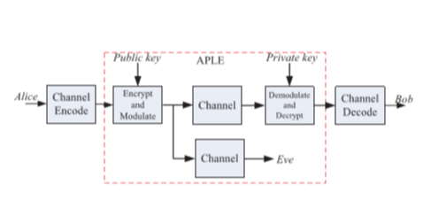
Methodology
System model of APLE

Slide 11
An APLE system consist of message space M , cipher space C and key space K.
Key generation algorithm G:→K×K0. G is a probabilistic algorithm that outputs a key pair( K, K0)∈K×K0.
Encryption algorithm T: M ×K→C.
Channel function HB :C→Z , ZB = HB(Y).
Z is the set of all possible ZB, and ZB ∈Z.
Decryption algorithm D: Z×K’ →M.
The above model only deﬁned for a single user scenario.

Slide 12
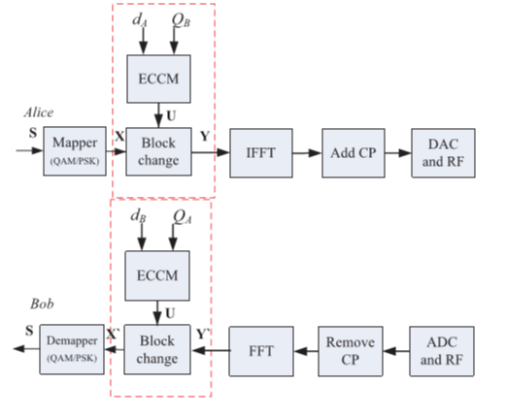
APLE algorithm based on elliptic curve cryptography

Slide 13
Elliptic curve cryptography:
An elliptic curve E deﬁned over a ﬁnite ﬁeld GF(p) is a set of points P=(x,y), where x and y are elements of GF(p) that satisfy a certain equation is,
(1)
There are deﬁnitions of addition, subtraction, and scalar multiplication operations on elliptic curves, which are different from operations on the ordinary number ﬁeld.
(2)
NIST recommends ﬁve prime ﬁelds for certain primes p of sizes 192, 224, 256, 384, and 521 bits.

Slide 14
APLE algorithm
Algorithm divided into four steps:
Private and public key pairs generation
Public keys exchange
Security matrix generation
Block change and secure communication
Private and public key pairs generation:
Following key generation primitive is used by each user to generate the individual public and private key pairs.
Chose a random integer d from {1,··· ,n−1}
Compute Q=d ×G.

Slide 15
Public key exchange:
A and B exchange their public keys QA and QB over a public channel.
Security matrix generation:
A and B calculates it Sk by using the equation ,
Sk =dAQB =dA(dBG)=dB(dAG)=dBQA (3)
Block change and secure communication:
The process of encryption at Alice ,
Y =UX (4)
The process of encryption at Bob ,
X’=UHY’ (5)

Slide 16
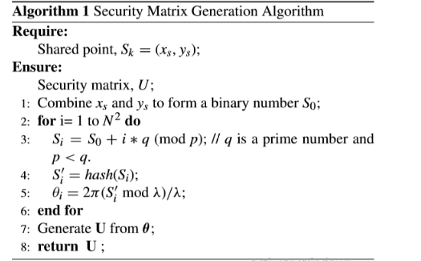

Slide 17
1) Hash function:
The purpose of the hash function is to shufﬂe the data so that the distribution of the rotation angles is more uniform and random.
2) Rotation direction vector generation:
Considering the range of θi is (0,2π) , and author using a mapping function ,
(6)

Slide 18
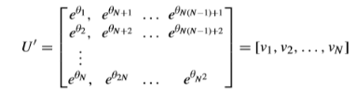
3) Generation of U from θ:

Slide 19
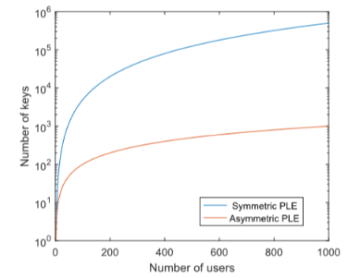
Comparison of APLE and PLE:

Slide 20
Applications
One such application is a system comprising a medical sensor device and a wireless communication module.
The recent applications of PLS techniques to different emerging communication systems VLC ,BAN,PLC,IoT and etc.
Unmanned Aerial Vehicle (UAV) Communication.
Vehicular social networks (VSN) emerging field where APLE contributed alot.

Slide 21
Conclusion
Proposed framework establishes cryptographic primitive for an asymmetric physical layer encryption system, which provides a new path for PLE system design
Asymmetric physical layer encryption scheme based on elliptic curve cryptography is proposed.
Compared with the existing symmetric PLE scheme, the scheme does not need to perform key distribution.
More suitable for a multi-user communication scenario.

Slide 22
References
T. R. Dean and A. J. Goldsmith, ‘‘Physical-layer cryptography through massive MIMO,’’ IEEE Trans. Inf. Theory, vol. 63, no. 8, pp. 5419–5436, Aug. 2017.
S. Wang, W. Li, and J. Lei, ‘‘Physical-layer encryption in massive MIMO systems with spatial modulation,’’ China Commun., vol. 15, no. 10, pp. 159–171, Oct. 2018.
Xinjin LU and Jing LEI “Physical Layer Encryption Algorithm Based on Polar Codes and Chaotic Sequences,” vol. 07,no.9 ,Jan.2019
Wei LI , Des Mclernon , Kai-Kit Wong , “Asymmetric Physical Layer Encryption for Wireless Communications” vol. 7 , pp. 46960-46967,Apr.2019.

Slide 23
THANK YOU

